Slide 1
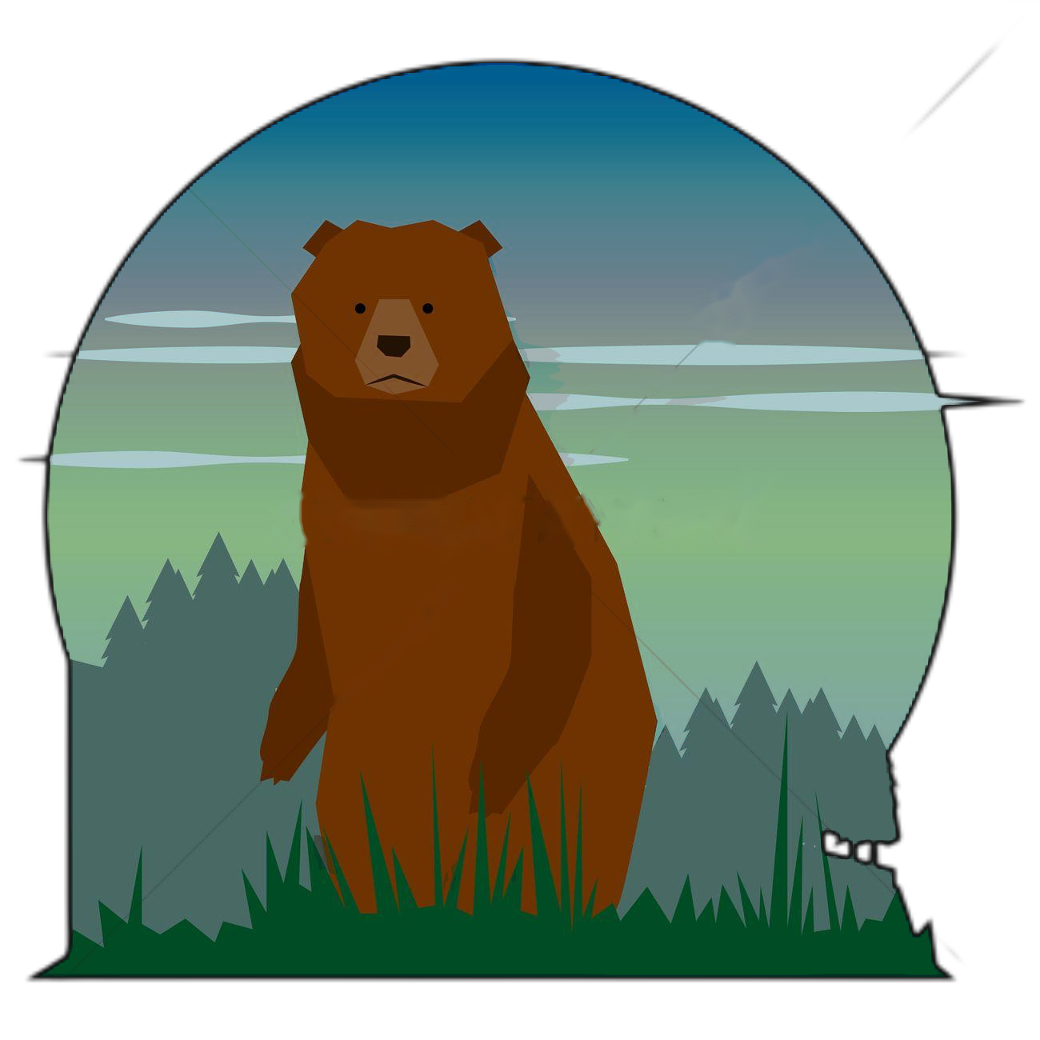

Final Project
Wildlife Photography
Maoqin Zhu Xinyang Mao
Yukai Chen
Instructor: Evangelos Kalogerakis
Introduction
Project Progress
Decision Tree
Grading Algorithms
Demo
1

Slide 2

Introduction
We are controlling a wildlife photographer, and he is about to capture animal photos in the forest to earn points in a limitted time.
At the same time, he is supposed to avoid encountering beasts straightforward.
2

Slide 3
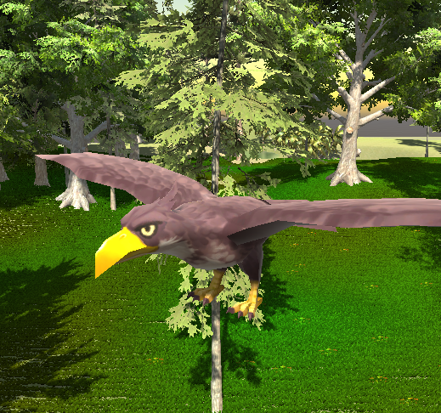
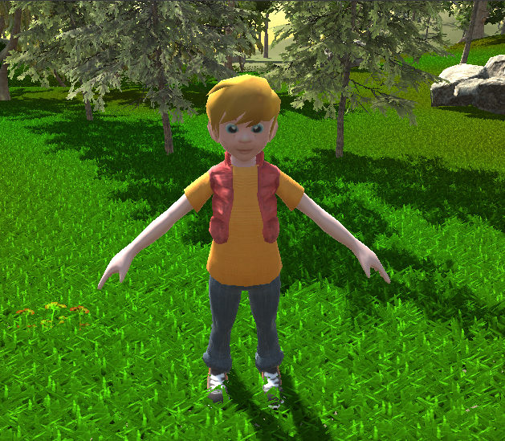
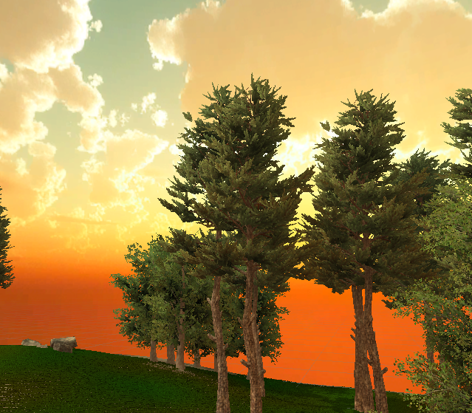
NPC (Wild Animals)
Player (Photographer)
User Interface
Decision Tree
Camera Switch
Forest Scene Design
Physics
Collision Detection
Scene Switch
Grading Mechanism
Grading Algorithm
Sound Effect
3

Slide 4
Key Elements: added 1 photographer, 10+ wild animals species, 3 forest scenes
What we have done?
Game AI: designed 3 types of behavior tree, implemented 10+ trees for each animal species
Animation: realized basic physics, collision detection and rigid body simulation
Game Function: camera switch, basic grading algorithms, game rules, etc
4

Slide 5
Finetune parameters and physics codes to better depict animals random movements & actions
Tasks To Do
Optimize grading algorithms and game rules
Add guiding compass, menu, sound effect, scene switch and pause function
5

Slide 6

Decision Tree
6

Slide 7

4 Important Classes
Node.cs
Selector.cs
Sequence.cs
Tree.cs
7

Slide 8



Node Types
Node States
?
Selection Node
Failure
Sequence Node
Running
Functionality Node
Completed
8

Slide 9
Sequence Node
get/set AttackMode
?
Selection Node
?
Functionality Node
Sit
Sleep
hangAround
Walk
Idel
......
isInAttackZone
goAttack
isInApproachZone
goApproach
Priority
high
low
9

Slide 10
Sequence Node
get/set FleeMode
?
Selection Node
?
Functionality Node
Sit
Sleep
hangAround
Walk
Idel
......
isInFleeZone
goFlee
Priority
high
low
10

Slide 11
Grading Algorithms
11

Slide 12

Occulusion: use Raycast and GeometryUtility.TestPlanesAABB() to detect if animals are inside the camera view
Distance Between Animal and Player: gennerally speaking, the closer the player is, the higher score you’ll get
Camera Focal Length: since the camera focal length is adjustable to player, a proper focal length can help you get higher score
Animal Species: for different animal species, we assigned a proper coefficient when grading. The nmber of animal species the player found is also important
12

Slide 13

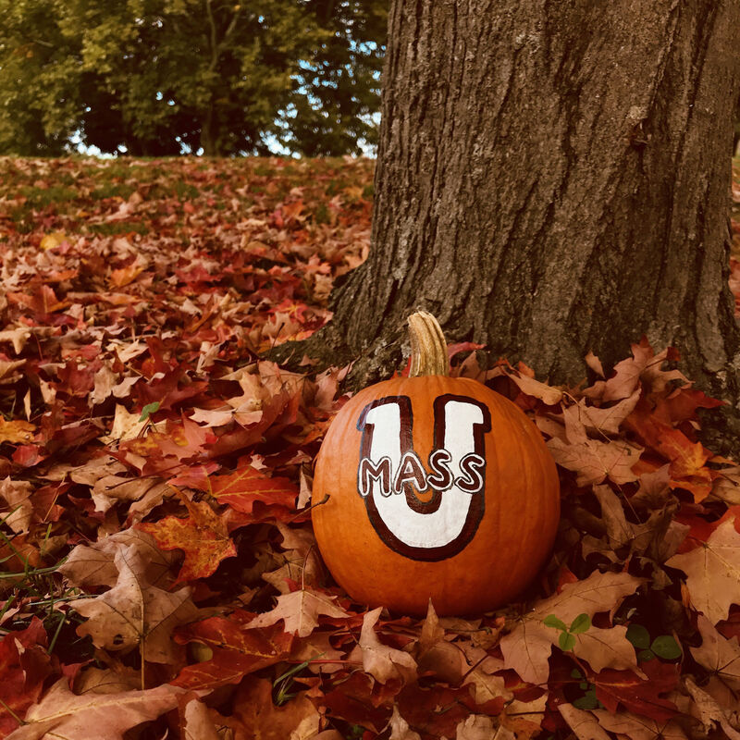
Live Demo !
13

